Slide 1
Extract Transform and Load
Traveler’s Guide – Allergy Friendly Restaurants in Mexico

Slide 2
Over view
Data sources
Transformation
SQL
Final Report
Conclusion

Slide 3
Data SOURCE
Two csv files from different sources were used
rating_final.csv
geoplaces2.csv

Slide 4
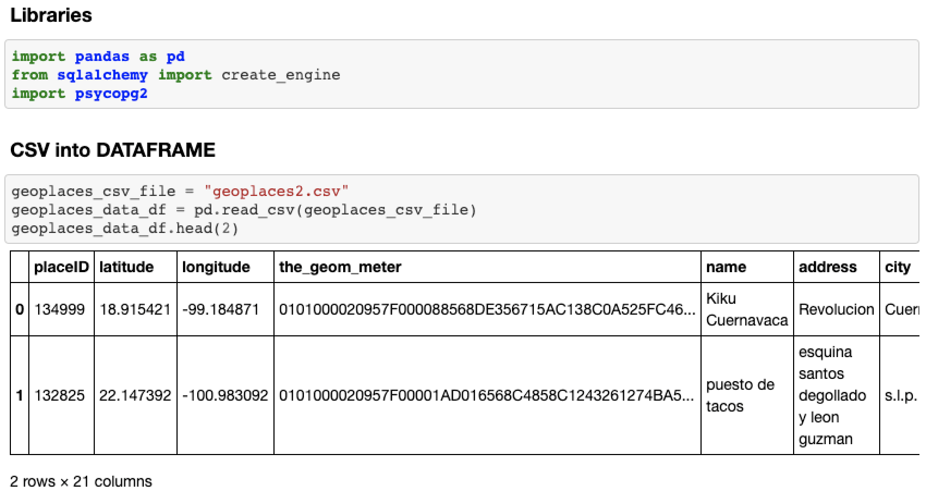
transformation

Slide 5
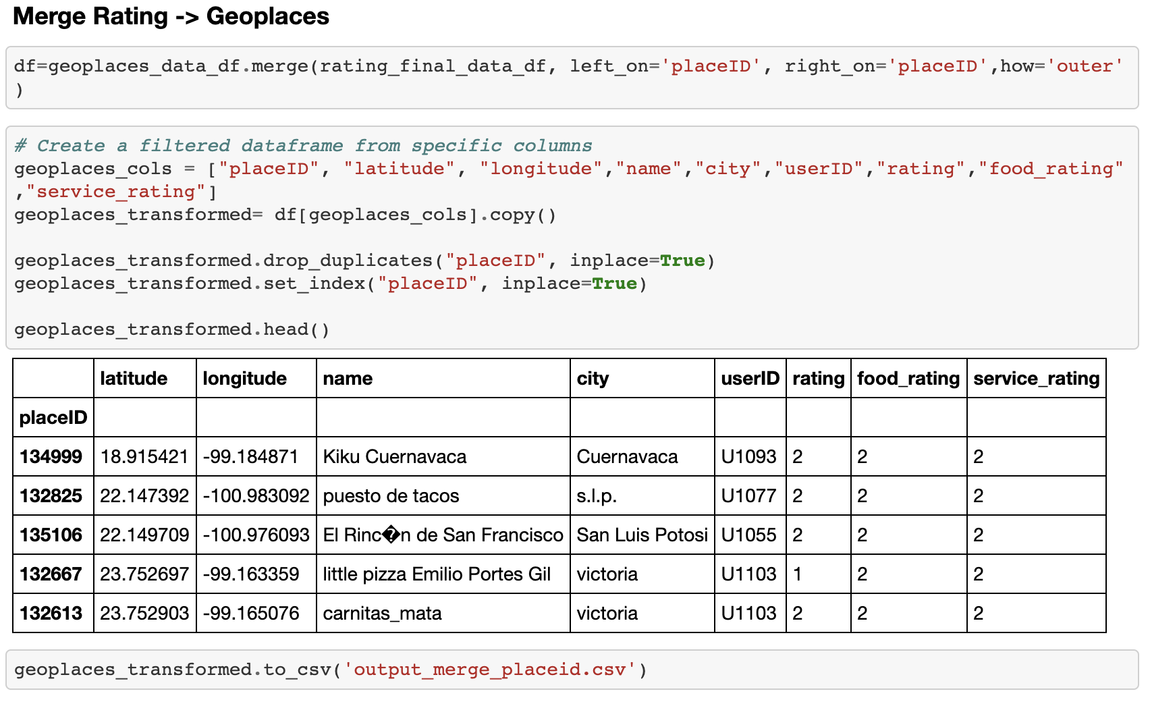
transformation

Slide 6
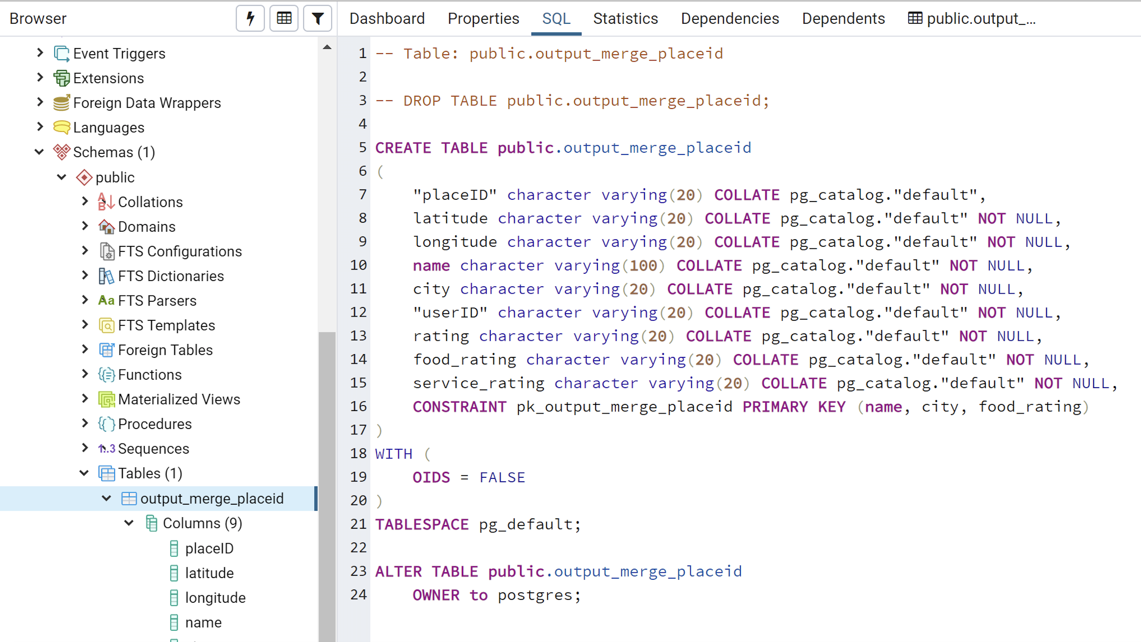
SQL

Slide 7
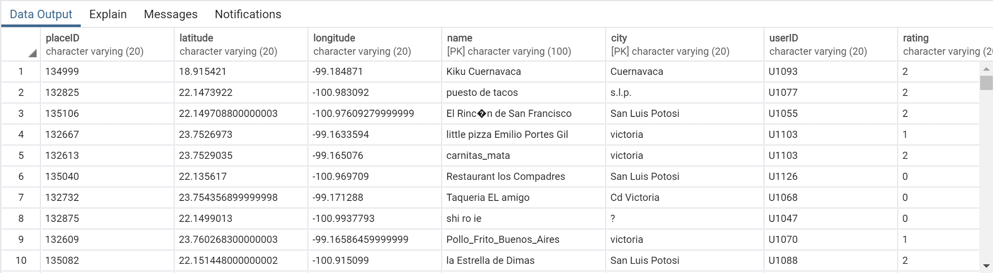
SQL

Slide 8
URL
https://bit.ly/30hufq1

Slide 9
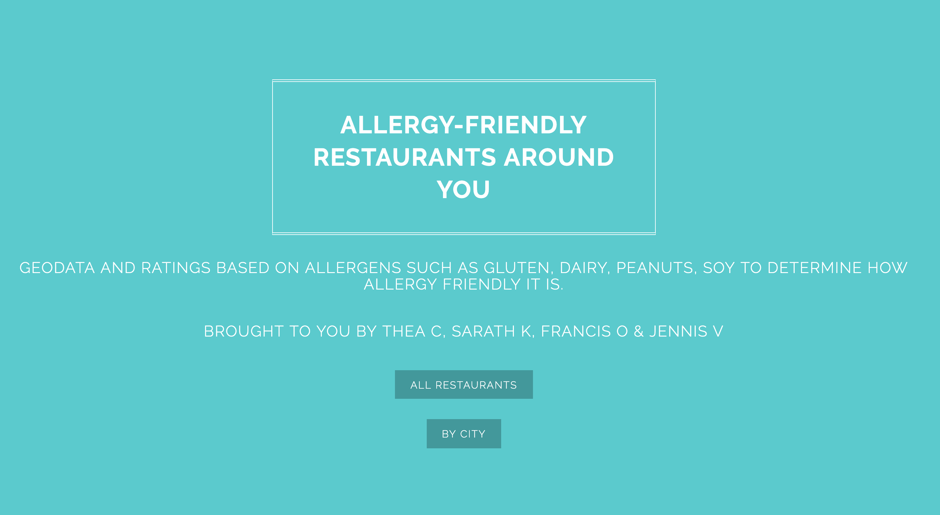
HTML

Slide 10
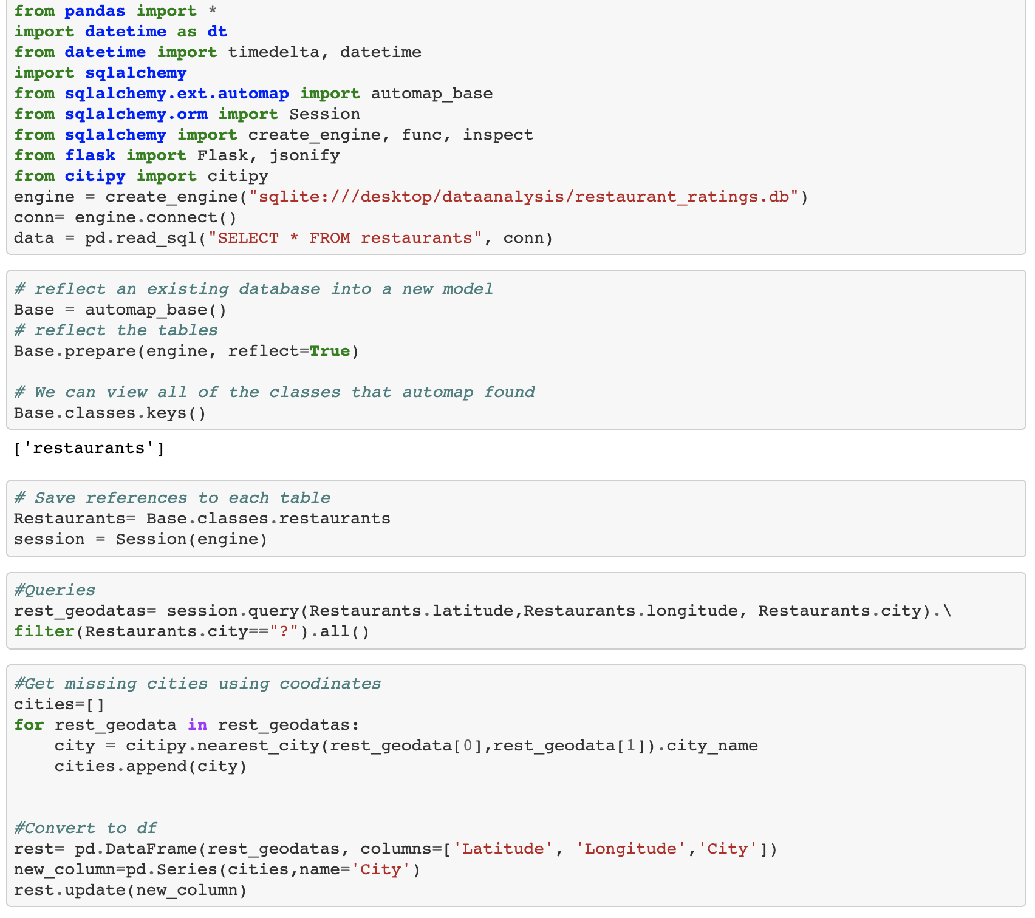
HTML

Slide 11
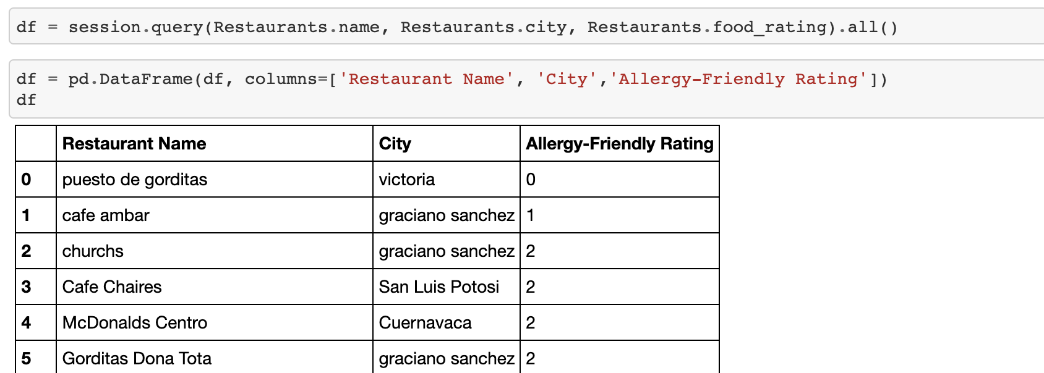
HTML

Slide 12
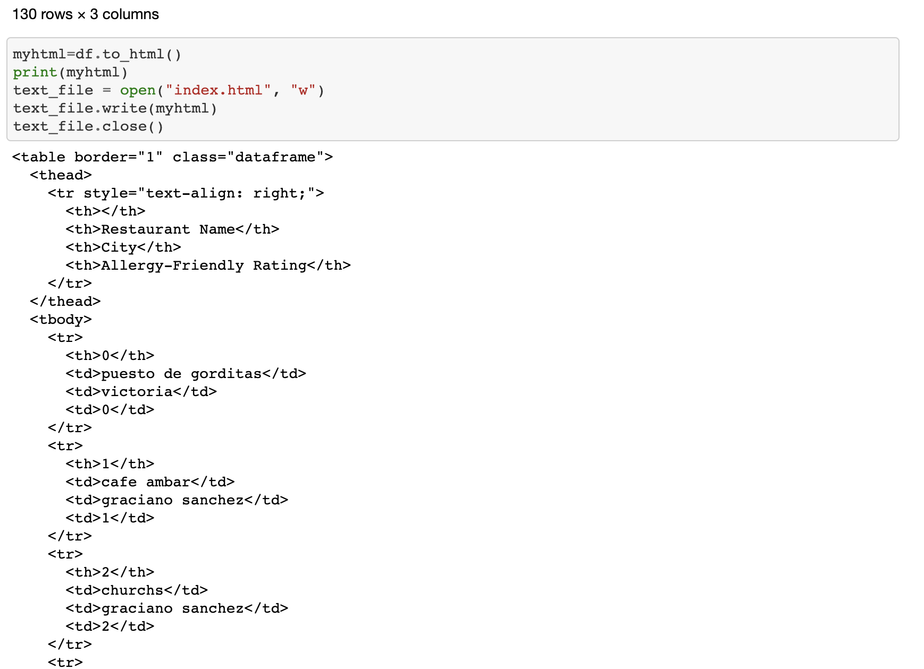
HTML

